Slide 1


The Renovation of Collective Centers for Georgia’s Internally Displaced Persons
Transparency International Georgia
საერთაშორისო გამჭვირვალობა - საქართველო
Lasha Gogidze - Researcher/Analyst
23 September 2011,
Tbilisi

Slide 2
Background Information
Main donor of the projects for rehabilitation
of collective centers:
European Union
Supervising agency of implemented projects:
Municipal Development Fund of Georgia
Total costs of implemented projects:
GEL 91 million

Slide 3
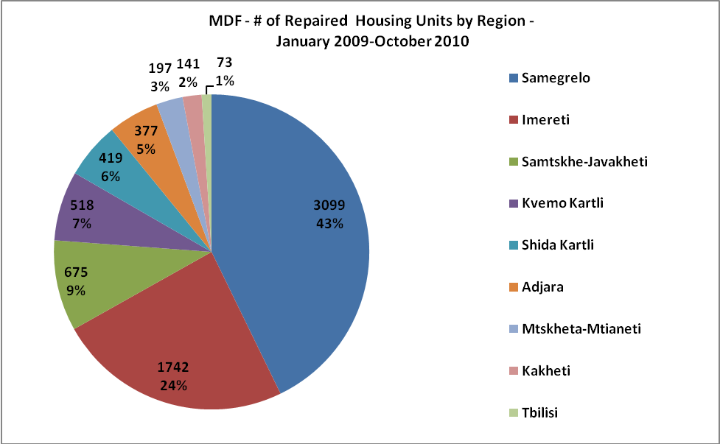
Background Information
In total, 273 buildings/7,241 apartment units have been renovated in different regions of Georgia for the “first wave” of IDPs.

Slide 4
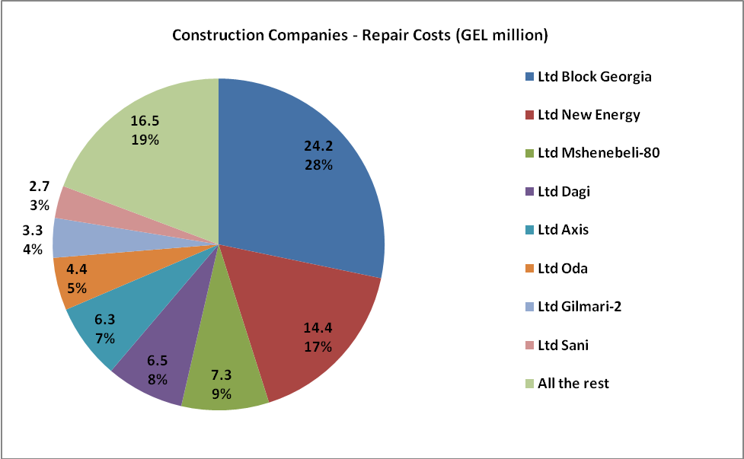
Background Information
The majority of repair works, by cost, was completed by three companies –
Ltd Block Georgia, Ltd New Energy and Ltd Mshenebeli-80.

Slide 5
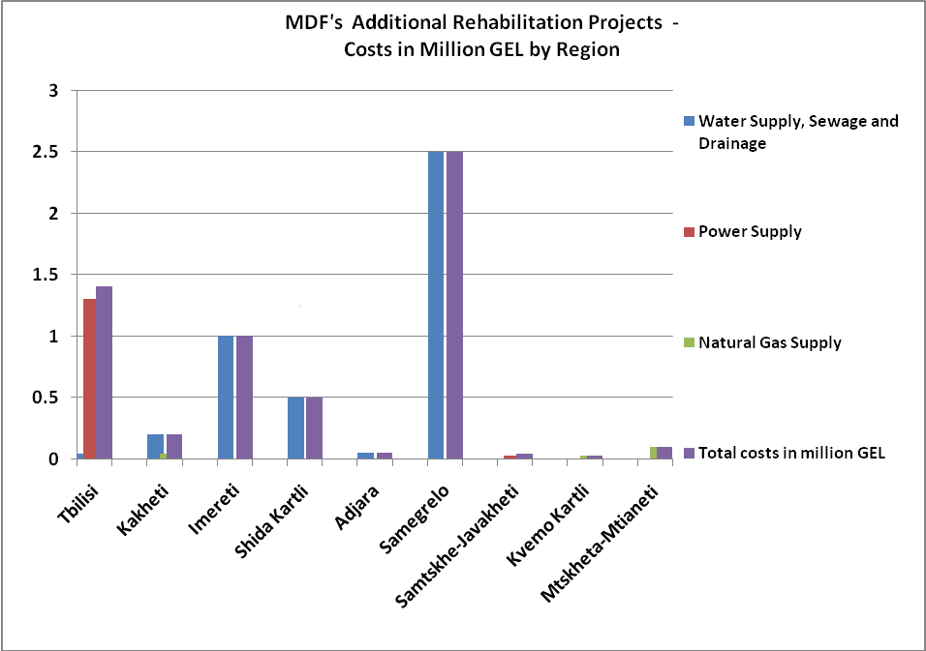
Background Information
Additional rehabilitation projects differed a lot by region.

Slide 6
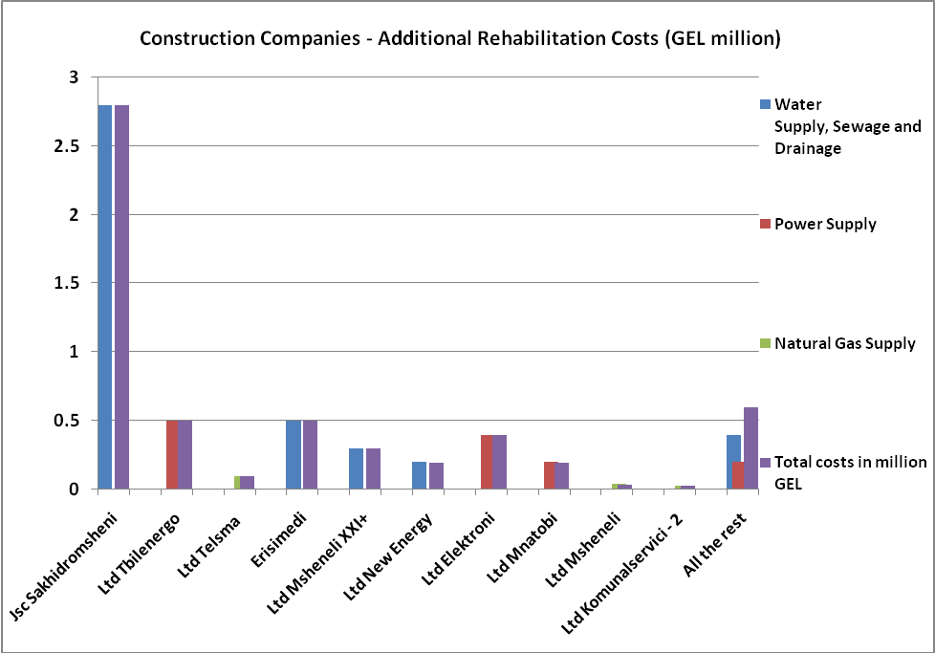
Background Information
JSC Sakhidromsheni, which was in charge of fixing water supply and sewage systems, has managed most of the funds (GEL 2.8 million) for additional rehabilitation projects

Slide 7
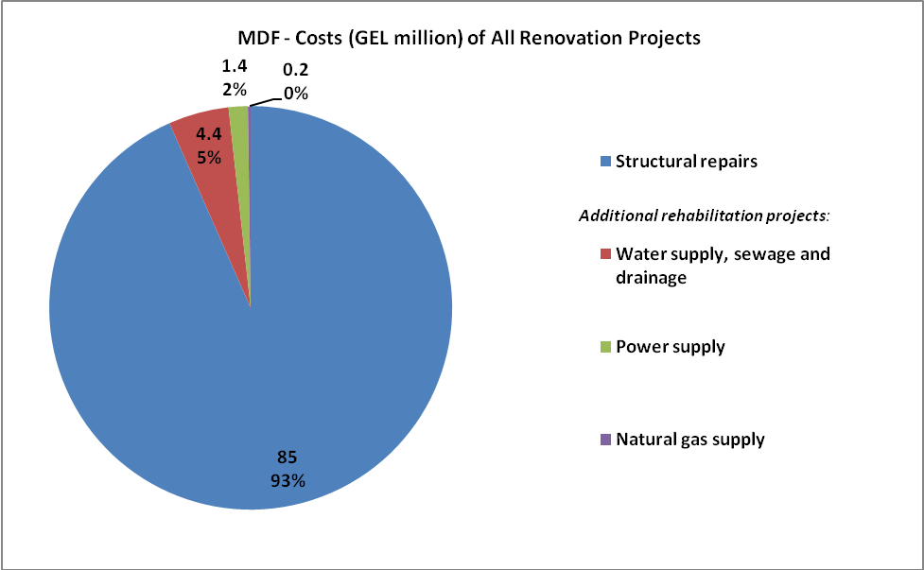
Background Information
Total costs of all rehabilitation projects by type of renovation

Slide 8
Research Methodology
Concerns about the low quality of renovation of collective centers were particularly acute in western Georgia, where MDF implemented approximately 80 percent of all its housing rehabilitation projects for IDPs.
Main objective of the report:
Assess the quality of renovation of old collective centers in western Georgia and to grasp IDPs’ general attitudes and opinions about the renovations.

Slide 9
Research Methodology
MDF has overseen the renovation of 215 buildings with 5,218 apartment units in western Georgia.
Of these, TI Georgia’s research team visited 22 buildings (12 in Samegrelo, 5 in Imereti and 5 in Adjara) and conducted interviews with approximately 90 households in total – approximately four interviews per site visited.

Slide 10
Categorization of Collective Centers
In total, TI Georgia’s research team visited 22 buildings.
Of these, five buildings visited were of good conditions since they did not have any major defects and IDPs seemed to be generally satisfied with the work of construction companies.
Nine buildings were of acceptable conditions but had a number of obvious defects (e.g., cracked walls and ceilings, dampness and mould, unfixed electricity cables).
Eight buildings were of rather bad conditions and had major renovation problems (e.g., severe dampness and mould, unfixed drainage and sewage infrastructure, low quality of building materials and actual repair works, and limited or no water supply).

Slide 11
Five Main Categories of
Problems Identified
Serious dampness and mould
Low quality of buildings materials and repair works
Problems with the supply of tap water and the management of waste
Failure to fix renovation defects
Delayed privatization process

Slide 12
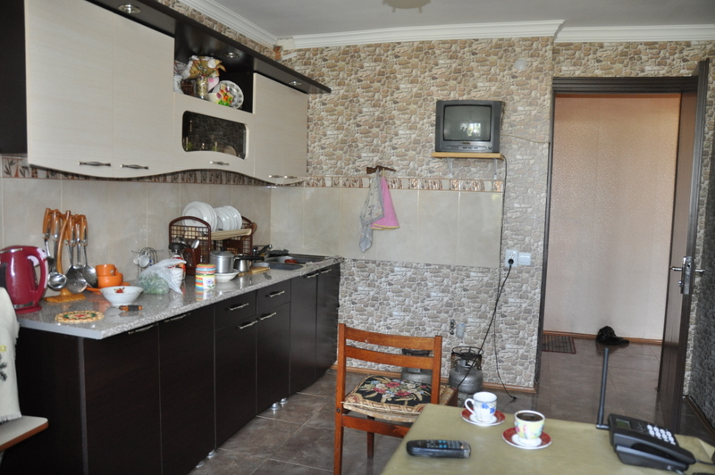
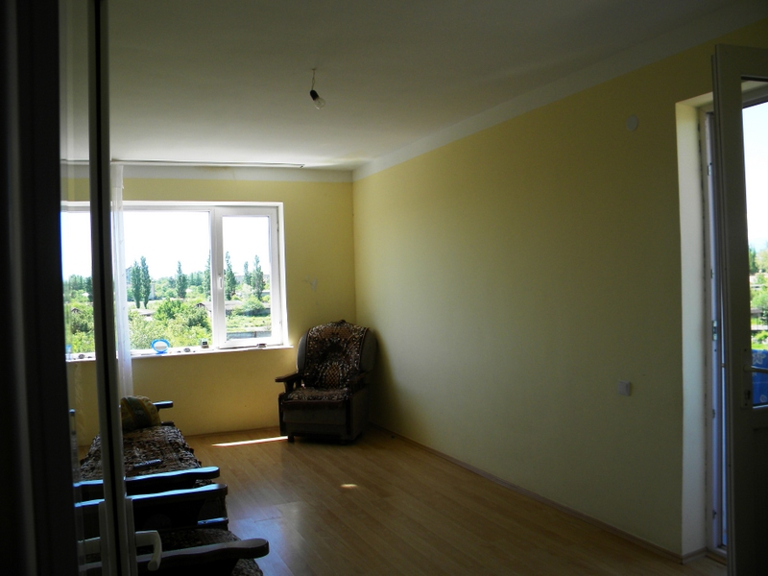
A Flat in the Marine Academy Located on Khinikadze Street # 4 in Batumi
A Flat in the Former Cooperative College in Kutaisi (located on Nikea Street # 12);

Slide 13
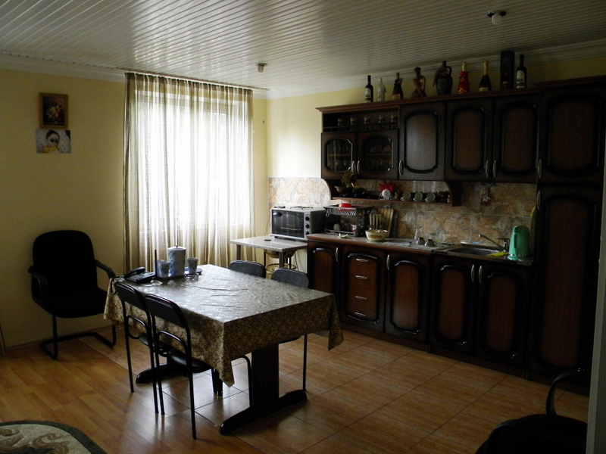
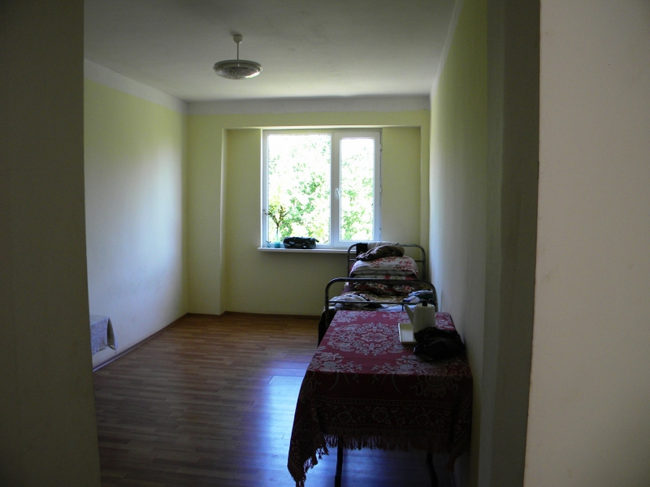
A Flat in the Former Boarding
School in Akhalsopeli
A Flat in the House # 2 in
Bandza Village

Slide 14
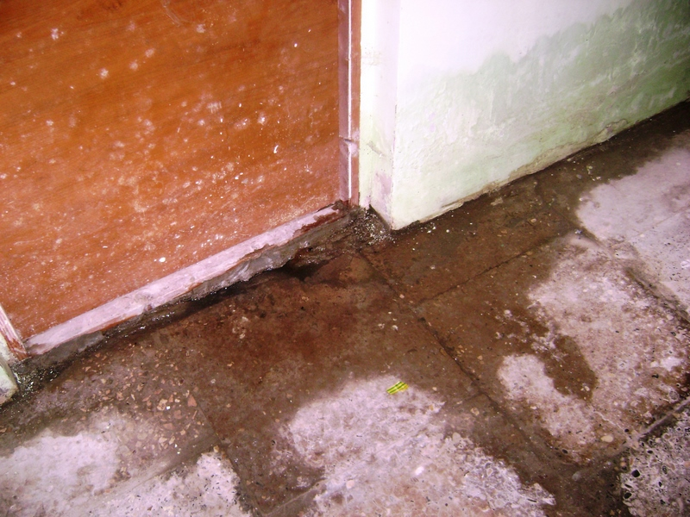
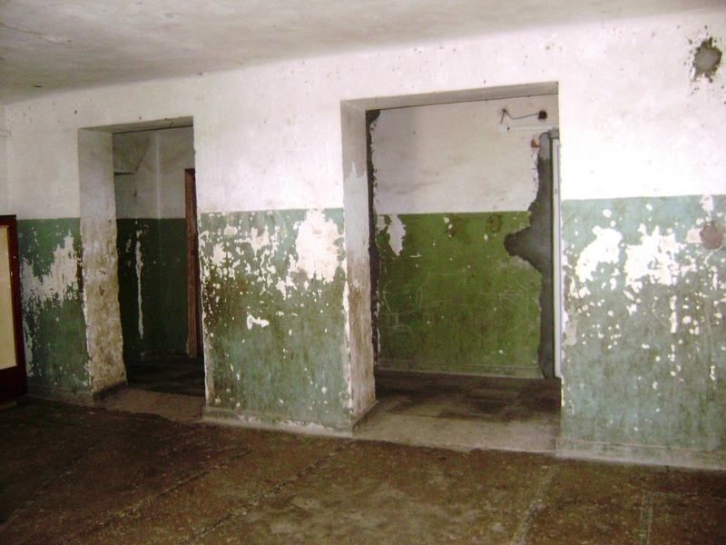
A Hallway in the Former Vocational School Building #4 in Nojikhevi Village
A Hallway in the Former School Building in Senaki (located on Rustaveli Street # 112);

Slide 15
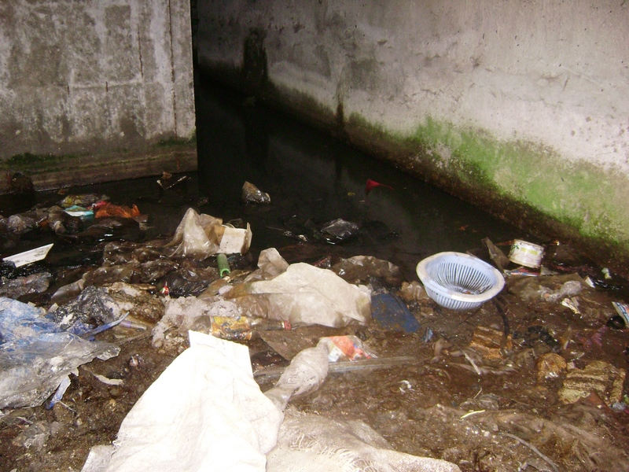
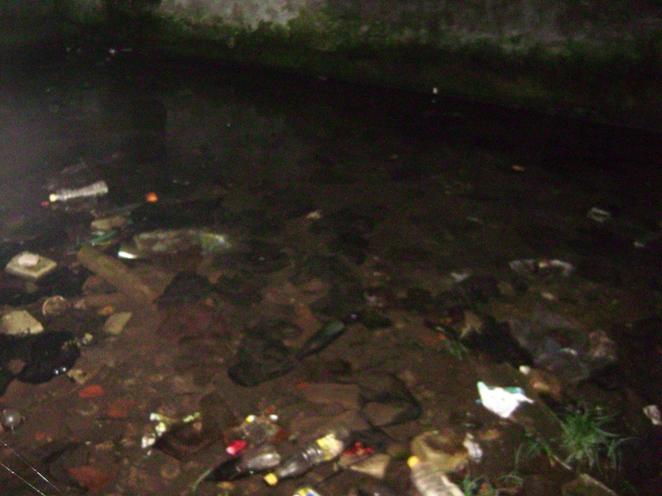
Basement of the House # 210 in the Senaki Military Settlement
Basement of the School # 3 in Chkhorotsku Town

Slide 16
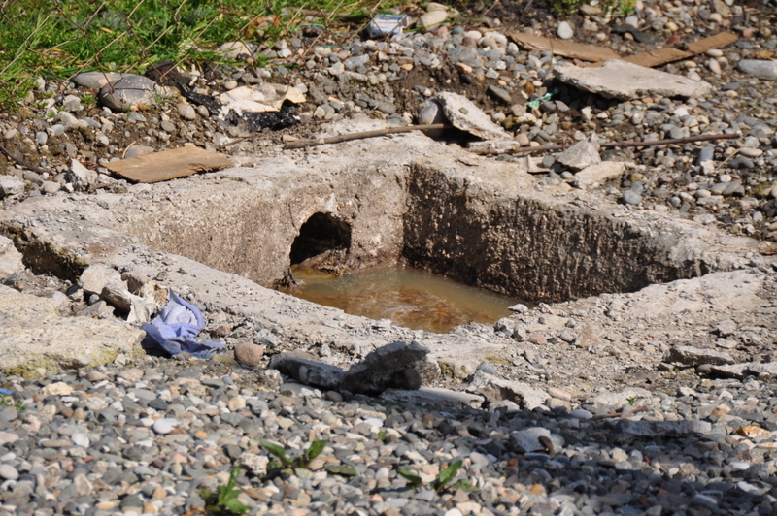
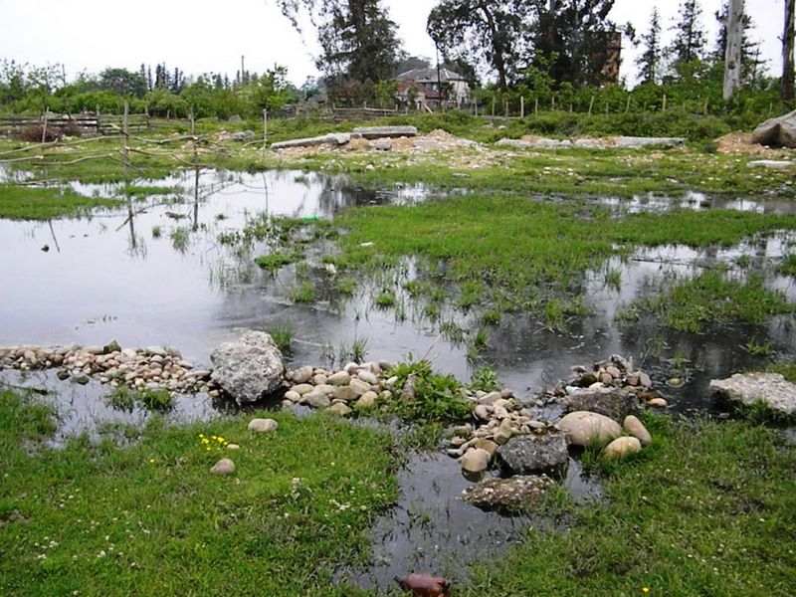
Outdoor of the Former Drug Abuse Dispensary in Batumi (located on Khakhuli Street # 5)
Outdoor of the Vocational School Building # 1 in Ingiri Village

Slide 17
Recommendations
Selection and structural assessment of existing buildings for rehabilitation should be better coordinated.
Repair works need to be tailor-made to the particular needs and conditions of each building concerned.
Defects documentation and supervision mechanism should be improved.
New redress mechanism for IDPs’ complaints about the quality of renovation to their housing should be well-explained to IDPs.

Slide 18
Recommendations
Delivery of municipal services to IDPs should be improved to solve the water, gas and waste management problems in the renovated collective centers.
Specific timeline should be set for the self-privatization of each collective center and this process should be finalized by the end of 2011.

